Slide 1
Spotify Trends using Tableau
In the above trend we would like to analyse the recommendations as per dashboard for advertisement team
To stay competitive.

Slide 2
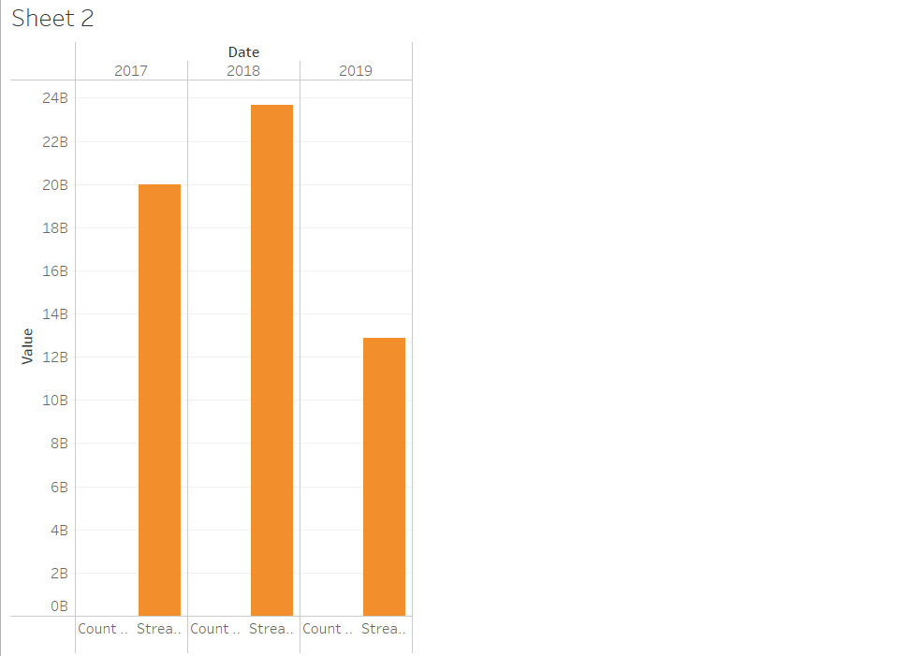
In above visuals we can view the graphs in the year 2017-19
The graphs are visible the streams in billion streams

Slide 3
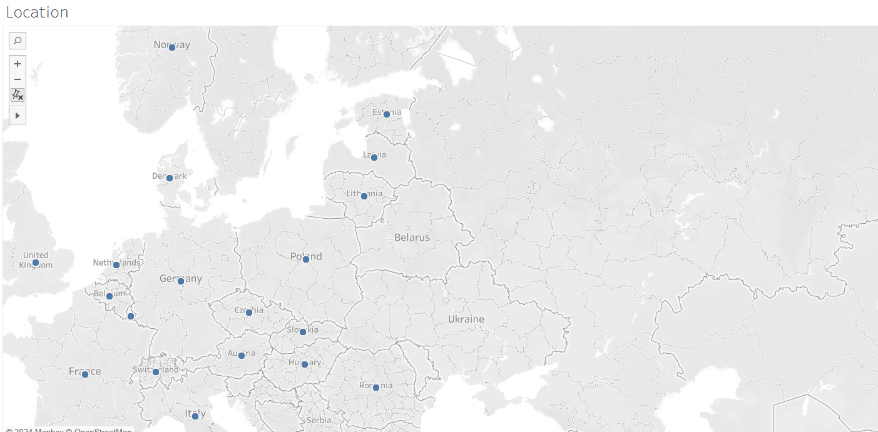
In above map we can view the location in which Streams are been more number of users are situated.

Slide 4
Key performance indicator (KPI):
Total Streams by Country: Identify the countries with the highest streaming volumes
Top Artists by Total Streams: Recognize the most popular artists.
Top Tracks by Total Streams: Determine the most streamed tracks.
Average Streams per Track: Measure the average popularity of tracks
Tracks with the Longest Duration at Position 1: Find tracks that consistently stay at the top.

Slide 5
Recommendation for advertiser for be competitive in music industry:
Localized Content: Develop ads that reflect the culture, language, and musical preferences of the target regions to increase relevance and engagement.
2) Feature Top Artists: Incorporate popular artists with high stream counts into ads. Artists like Drake, Ed Sheeran, or local favorites can boost ad visibility.
3) Dynamic Ad Insertion: Use listener data to insert ads that are relevant to the individual's music preferences, listening habits, and demographics
4) Visual and Multimedia Ads: Use engaging visuals, music videos, or animated content to make ads more appealing and memorable.
5) Artist Endorsements: Partner with popular artists for endorsements or to feature in ads. This can lend credibility and attract their fan base.
6) Event Sponsorships: Sponsor music festivals, concerts, and live events featuring popular artists to enhance brand visibility and engagement.
By leveraging data-driven insights, creating personalized and interactive ads, forming strategic partnerships, optimizing ad placements, and continuously monitoring and adapting strategies, the advertisement team can stay competitive in the dynamic music industry. These approaches ensure that ads resonate with listeners, maximize engagement, and effectively promote the brand or product.

